Slide 1
Process Description & Control
Covers Chapter#03 from Textbook

Slide 2
Suspended Processes (Cont.)
Q) Since swapping is an I/O operation, could it have the potential for making the problem worse rather than better?
A) Disk I/O is generally the fastest I/O on a system (e.g., compared to tape or printer I/O), hence swapping will usually enhance performance.

Slide 3
Suspended Processes (Cont.)
The OS has two options after performing a swapping-out operation:
Admit a newly created process into the memory.
Bring in a previously suspended process into the memory.
Preference should be to bring in a previously suspended process, to provide it with service rather than increasing the total load on the system.
However, it would not do any good to bring a blocked process back into main memory, if it is still not ready for execution.

Slide 4
Suspended Processes (Cont.)
To accommodate more possible combinations with the suspended concept, we need four states:
Ready: The process is in main memory and available for execution.
Blocked: The process is in main memory and awaiting an event.
Ready/Suspend: The process is in secondary memory but is available for execution as soon as it is loaded into main memory.
Blocked/Suspend: The process is in secondary memory and awaiting an event.

Slide 5
Fig. Process State Transition Diagram with Suspend States

Slide 6
Suspended Processes (Cont.)
Important new transitions are the following:
Blocked → Blocked/Suspend:
If there are no ready processes, then at least one blocked process is swapped out to make room for another process that is not blocked.
This transition can be made even if there are ready processes available. In particular, if OS determines that the currently running process or a ready process that it would like to dispatch requires more main memory to maintain adequate performance, a blocked process will be suspended.

Slide 7
Suspended Processes (Cont.)
Blocked/Suspend → Ready/Suspend: A process in the Blocked/Suspend state is moved to the Ready/Suspend state when the event for which it has been waiting occurs.
Ready/Suspend → Ready:
When there are no ready processes in main memory, the OS will need to bring one in to continue execution.
In addition, it might be the case that a process in the Ready/Suspend state has higher priority than any of the processes in the Ready state.

Slide 8
Suspended Processes (Cont.)
Ready → Ready/Suspend:
It may be necessary to suspend a ready process if that is the only way to free up a sufficiently large block of main memory.
Also, the OS may choose to suspend a lower–priority ready process rather than a higher–priority blocked process if it believes that the blocked process will be ready soon.

Slide 9
Suspended Processes (Cont.)
We can generalize the concept of a suspended process as having the following characteristics:
The process is not immediately available for execution.
The process may or may not be waiting on an event.
The process is placed in a suspended state by an agent: either itself, a parent process, or the OS.
The process may not be removed from this state until the agent explicitly orders the removal.

Slide 10
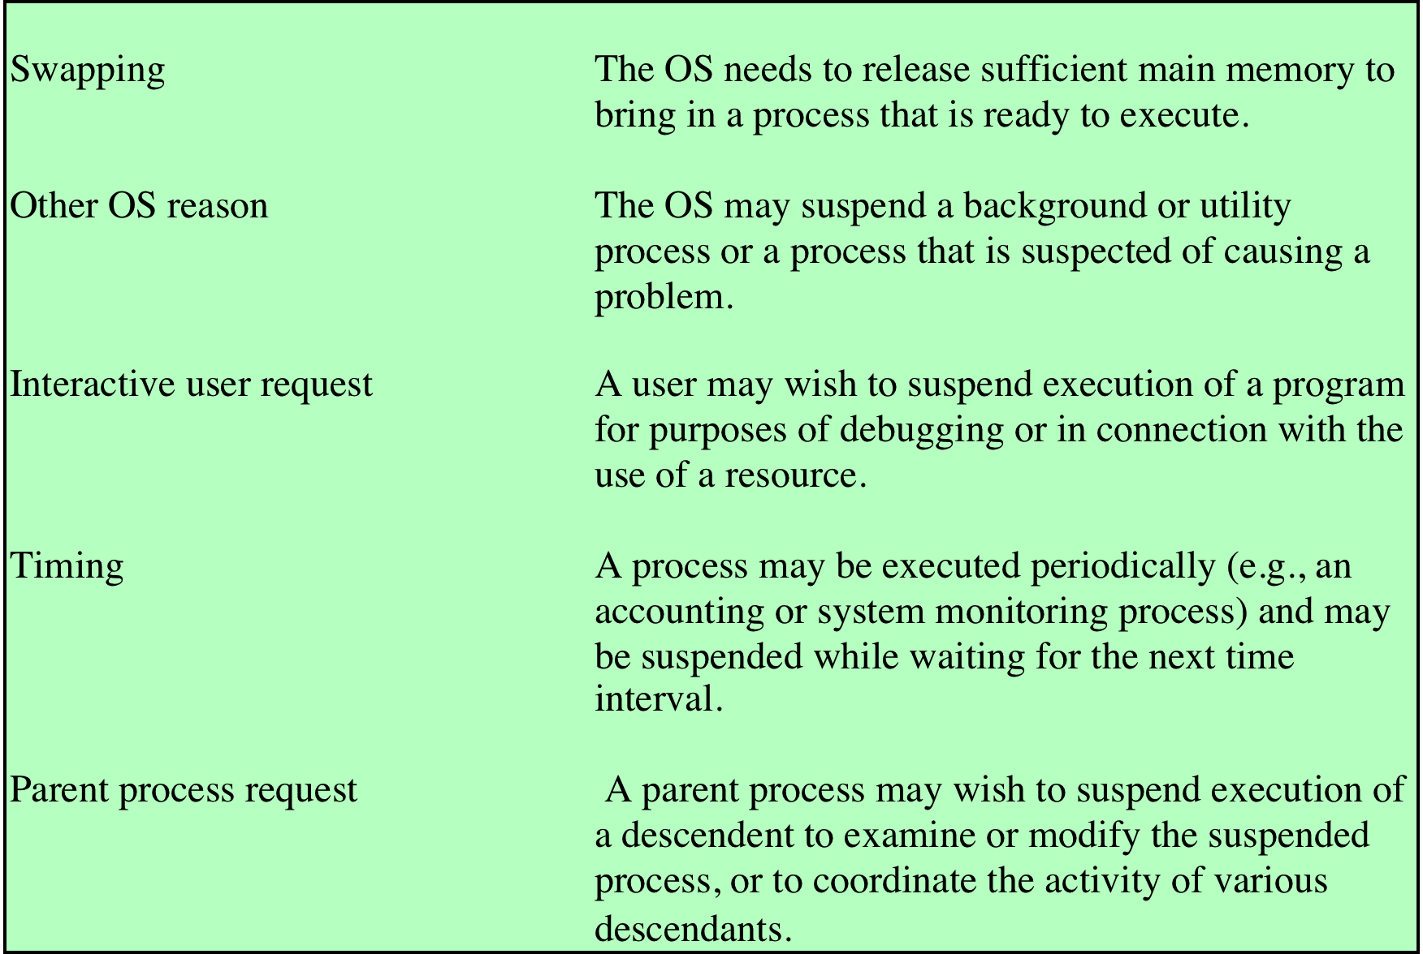
Reasons for process suspension.

Slide 11
Operating System Control Structures
The OS constructs and maintains tables of information about each entity that it is managing, which mainly include:
Memory tables: used to keep track of both main (real) and secondary (virtual) memory.
I/O tables: used by the OS to manage the I/O devices and channels of the computer system.
File tables: provide information about the existence of files, their location on secondary memory, their current status, and other attributes.
Process tables: manage processes.

Slide 12
Process Control Structures
The OS must know things regarding the process if it is to manage and control it:
Where the process is located.
Attributes of the process.

Slide 13
Process Location
Modern operating systems presume paging concept that allows physical memory to support partially resident processes.
At any given time, a portion of a process image may be in main memory, with the remainder in secondary memory.
Therefore, process tables maintained by the OS must show the location of each page of each process image.
Process image: the collection of program, data, attributes (PCB) and stack.

Slide 14
Process Location (Cont.)
Fig. Typical Elements of a Process Image

Slide 15
Process Attributes
We can group the PCB information into three general categories:
Process identification
Identifier of this process.
Identifier of the process that created this process (parent process).
User identifier.
Many of the other tables controlled by OS may use process identifiers to cross-reference process tables.

Slide 16
Process Attributes (Cont.)
Processor state information: Consists of the contents of processor registers.
User-Visible Registers: they may be referenced by means of the machine language that the processor executes while in user mode.
Control and Status Registers, e.g. PC.
Stack Pointers: points to the top of the stack.

Slide 17
Process Attributes (Cont.)
Process control information: additional information needed by OS to control and coordinate the various active processes.
Scheduling and State Information: (Process state, Priority, Scheduling-related information, Event).
Data Structuring: A process may be linked to other process in a queue, ring, or some other structure.
Interprocess Communication: Various flags, signals, and messages associated with communication between two independent processes.

Slide 18
Process Attributes (Cont.)
Process control information (Cont.):
Process Privileges: Processes are granted privileges in terms of memory access and the types of instructions that may be executed.
Memory Management: include pointers to segment and/or page tables.
Resource Ownership and Utilization: Resources controlled by the process may be indicated, such as opened files.

Slide 19
Process Attributes (Cont.)
PCB is the most important data structure in an OS, where it is read and/or modified by virtually every module in the OS.
A number of routines within OS will need access to information in PCBs, where provision of direct access to these tables is not difficult. The difficulty is not access but rather protection.
Two problems present themselves w.r.t. PCB:
A bug in a single routine, such as an interrupt handler, could damage PCBs.
A design change in structure of PCB could affect a number of modules in the OS.

Slide 20
OS Kernel and Processes
Typical Functions of an Operating System Kernel, w.r.t. process:
Process creation and termination
Management of process control blocks
Process scheduling and dispatching
Process switching
Process synchronization and support for interprocess communication

Slide 21
Thank You!

